Slide 1

AI in Higher Education: A Meta Summary of Recent Surveys of Students and Faculty
Week of April 20
Jacob Appling

Slide 2
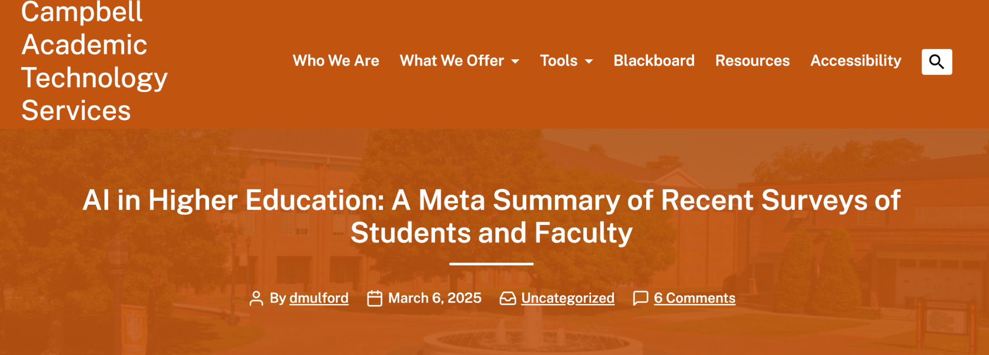
Article #4 (Row 4 via Google Sheet)

Slide 3
Link to the Source
https://sites.campbell.edu/academictechnology/2025/03/06/ai-in-higher-education-a-summary-of-recent-surveys-of-students-and-faculty/

Slide 4
Main Findings
The article argues that AI is already a major part of higher education, especially for students. Recent surveys show that a large majority of students are using AI tools for studying, writing, summarizing, brainstorming, explaining difficult concepts, and creating first drafts. For example, the article cites surveys showing student AI use ranging from 80% to 92%, depending on the survey group.
Faculty use of AI is growing, but it appears to be more cautious and less developed than student use. While many faculty members have tried AI or expect to use it more, the article notes that most faculty are still using it minimally. This creates a gap between how quickly students are adopting AI and how prepared instructors and institutions are to guide that use.
A major argument in the article is that AI literacy is now essential. Both students and faculty report feeling underprepared to use AI effectively. The article highlights concerns about accuracy, bias, privacy, academic integrity, cheating, and over-reliance on AI.

Slide 5
Broader implications for society
The broader social implication is that AI is becoming a basic skill for education and future employment. Students who learn how to use AI responsibly may be better prepared for workplaces where AI tools are common. However, students who lack access, training, or guidance could fall behind.
The article also raises concerns about fairness and equity. If some students have better access to AI tools or better instruction on how to use them, AI could widen existing educational gaps. This is especially important for first-generation students or students from underrepresented backgrounds.
Another implication is that society will need to rethink what learning, originality, and academic honesty mean. AI can help people learn faster and work more efficiently, but it can also make it harder to know whether a student truly understands the material. Because of this, schools will likely need clearer policies and more emphasis on ethics, critical thinking, and responsible use.

Slide 6
Relevance and potential influence on the construction industry
This article connects to the construction industry because construction education and professional training will likely face the same AI challenges as higher education. Future construction managers, engineers, architects, and facility professionals may increasingly use AI for research, scheduling, estimating, writing reports, reviewing documents, summarizing codes, and improving communication.
The article’s emphasis on AI literacy is especially relevant to construction. In construction management, AI tools can support decision-making, but users still need to verify information, understand project context, and avoid blindly trusting AI-generated answers. Mistakes in construction can have real consequences related to cost, safety, quality, and compliance.
For the construction industry, the biggest takeaway is that AI should be treated as a support tool, not a replacement for professional judgment. Companies and universities may need to train students and employees on how to use AI ethically, check its accuracy, protect sensitive project data, and apply it in practical ways that improve productivity without weakening critical thinking.

